Slide 1
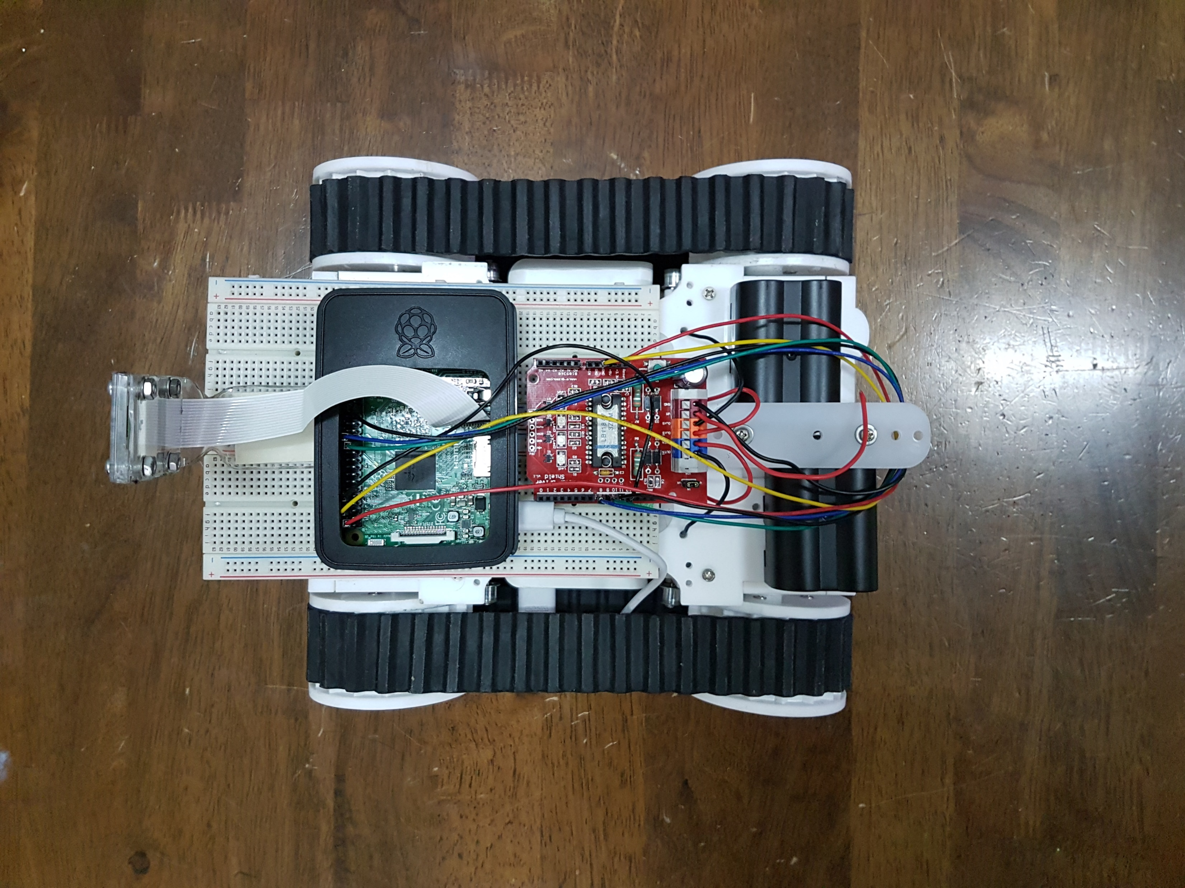
B
C
D
A
F
E

Slide 2
215 mm
262 mm

Slide 3
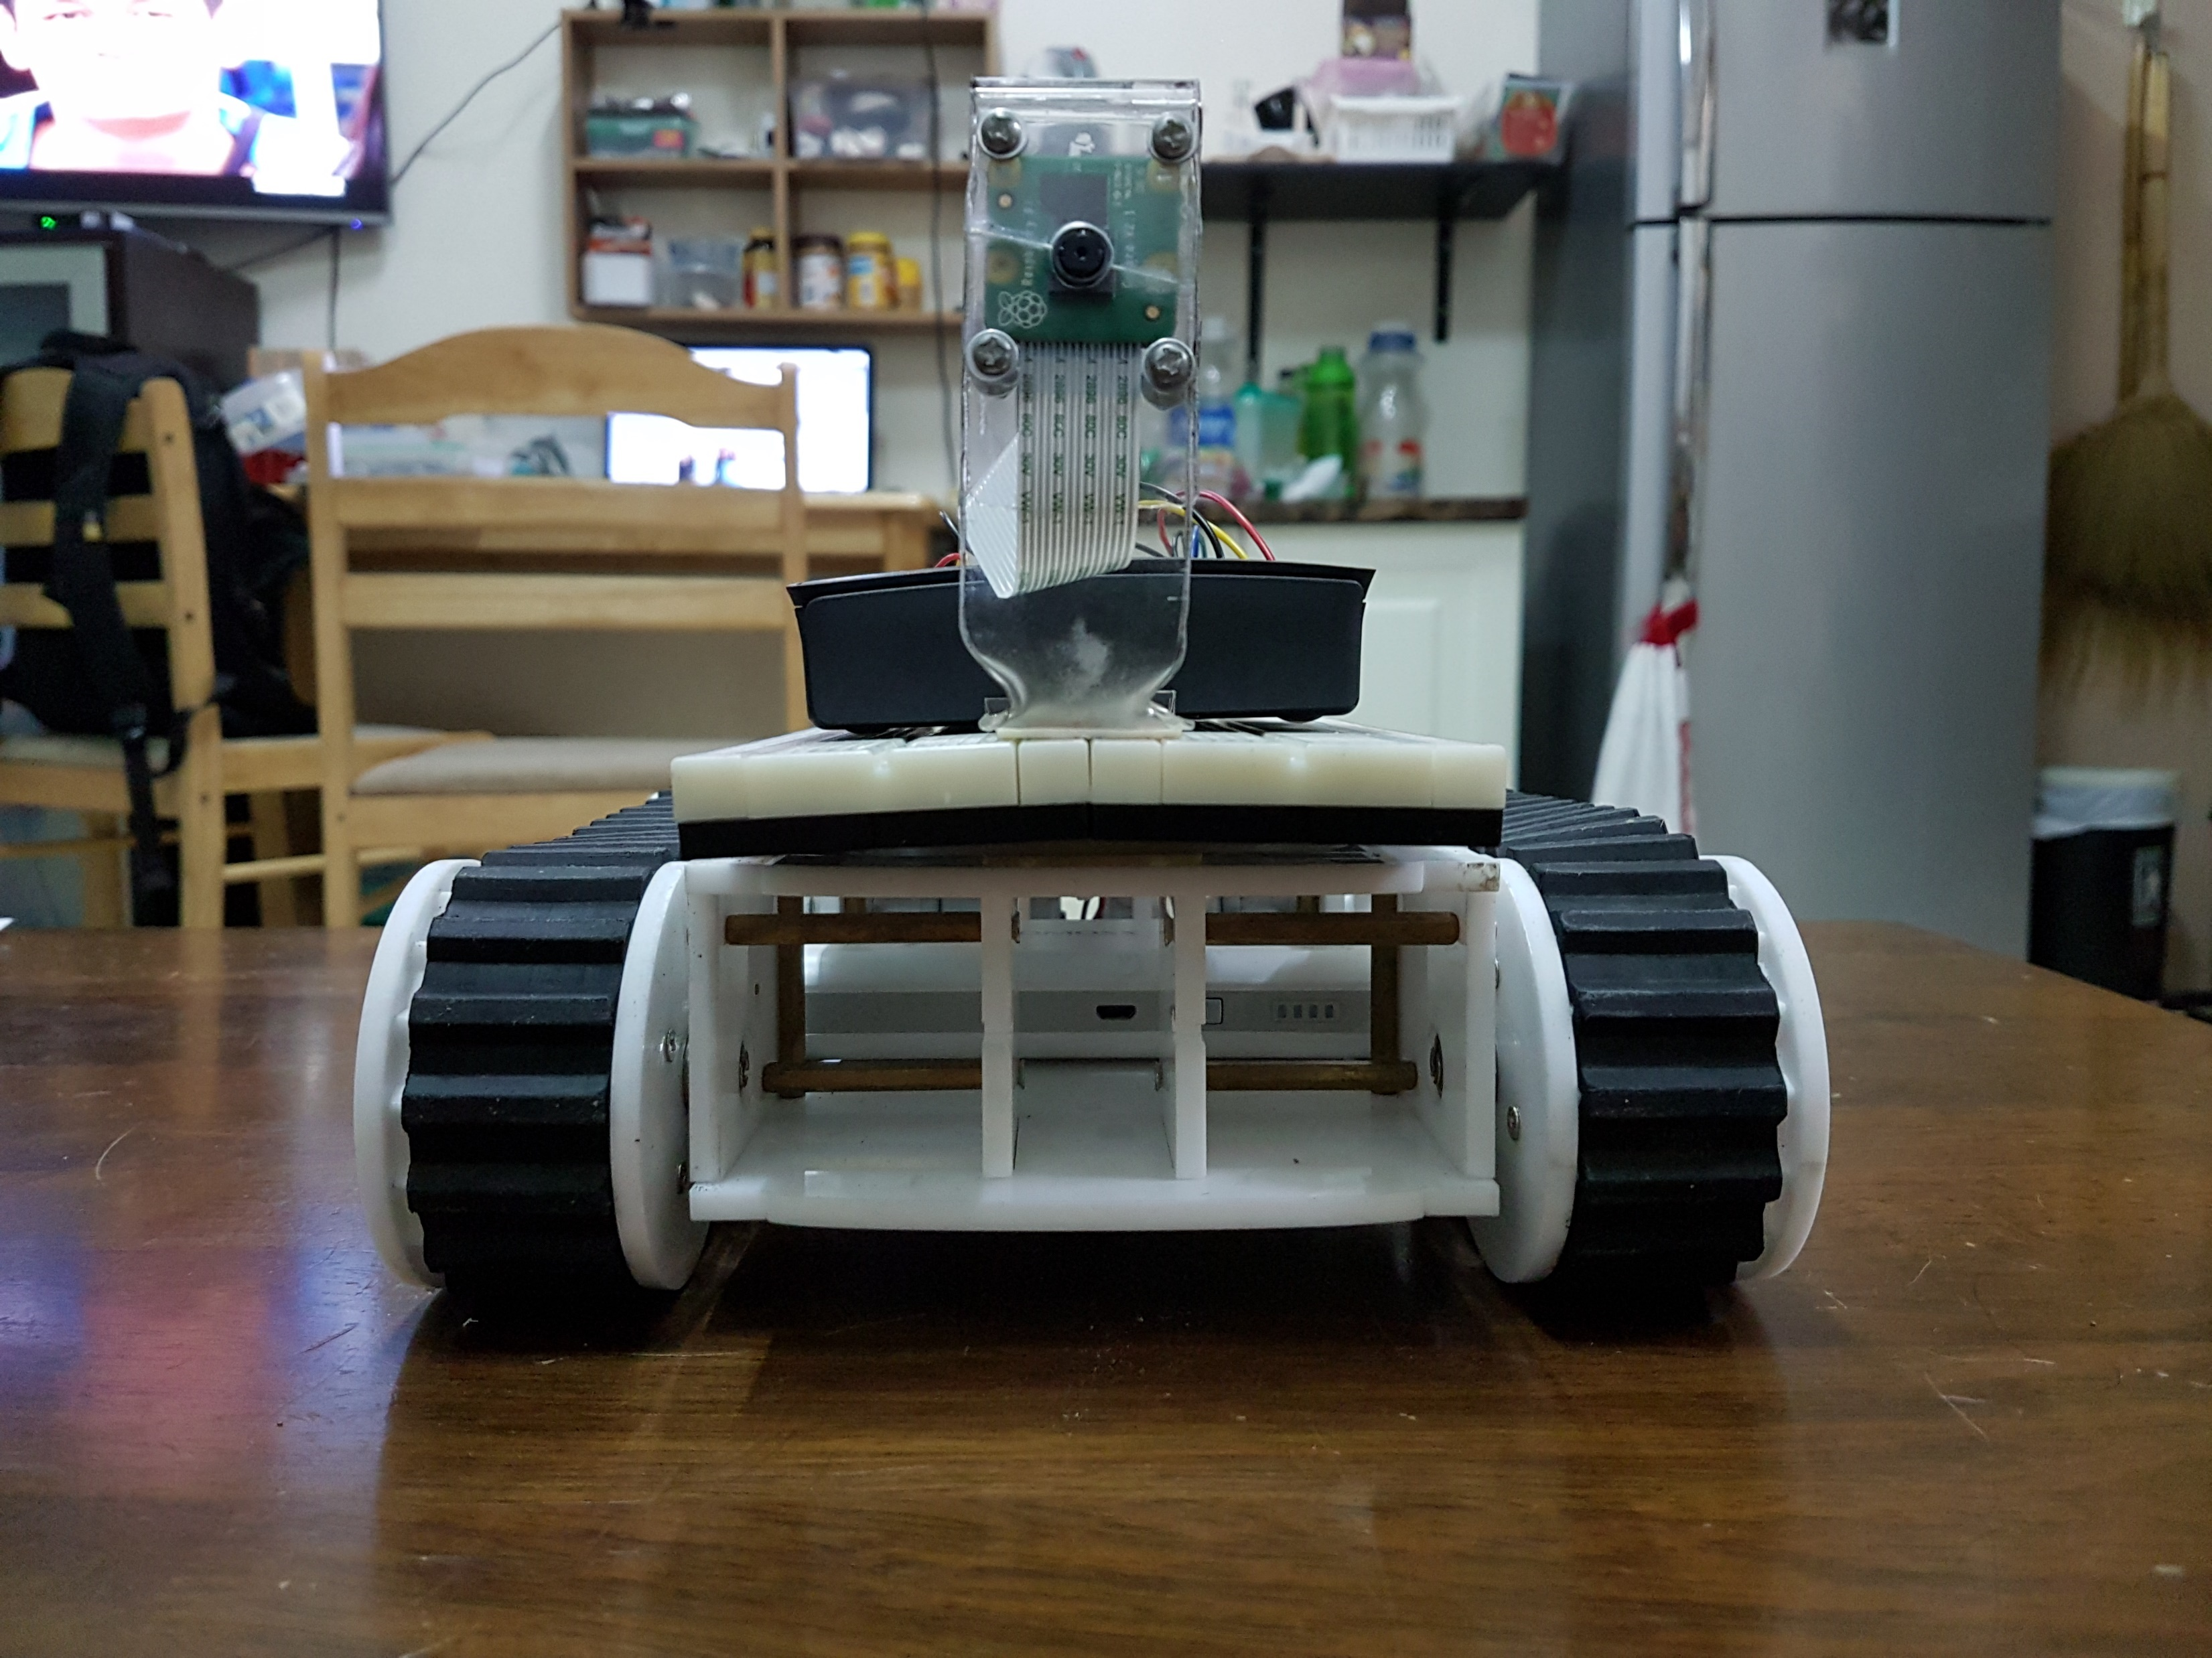
88 mm
180 mm
30 mm
215 mm

Slide 4
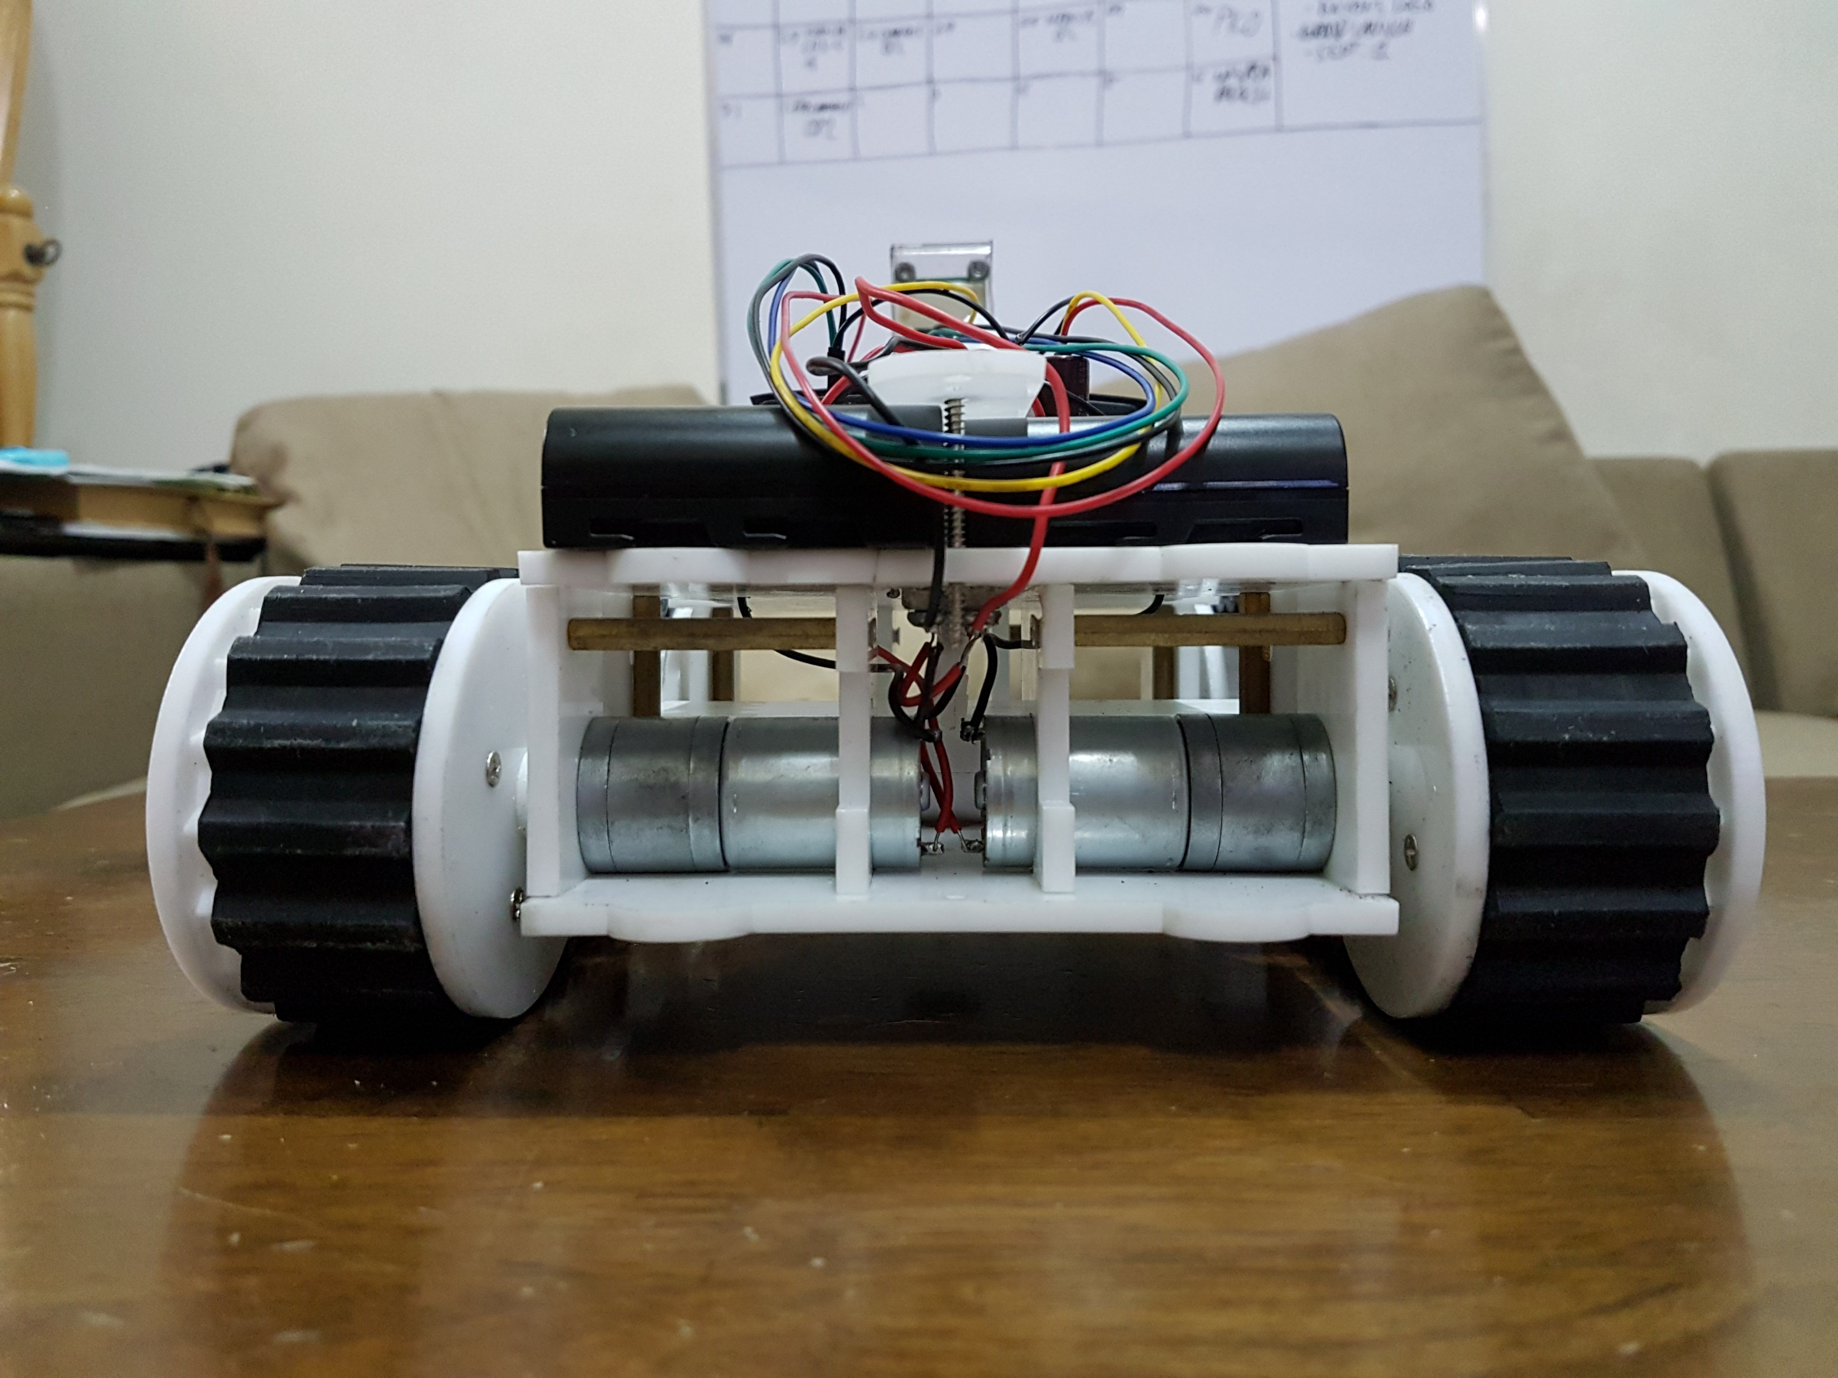
180 mm
215 mm

Slide 5
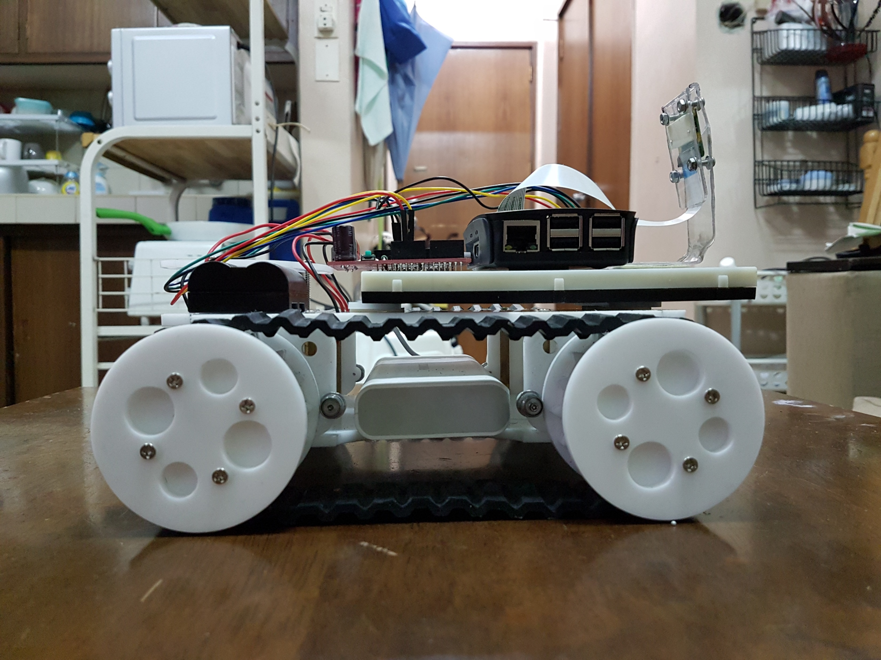
180 mm
262 mm

Slide 6
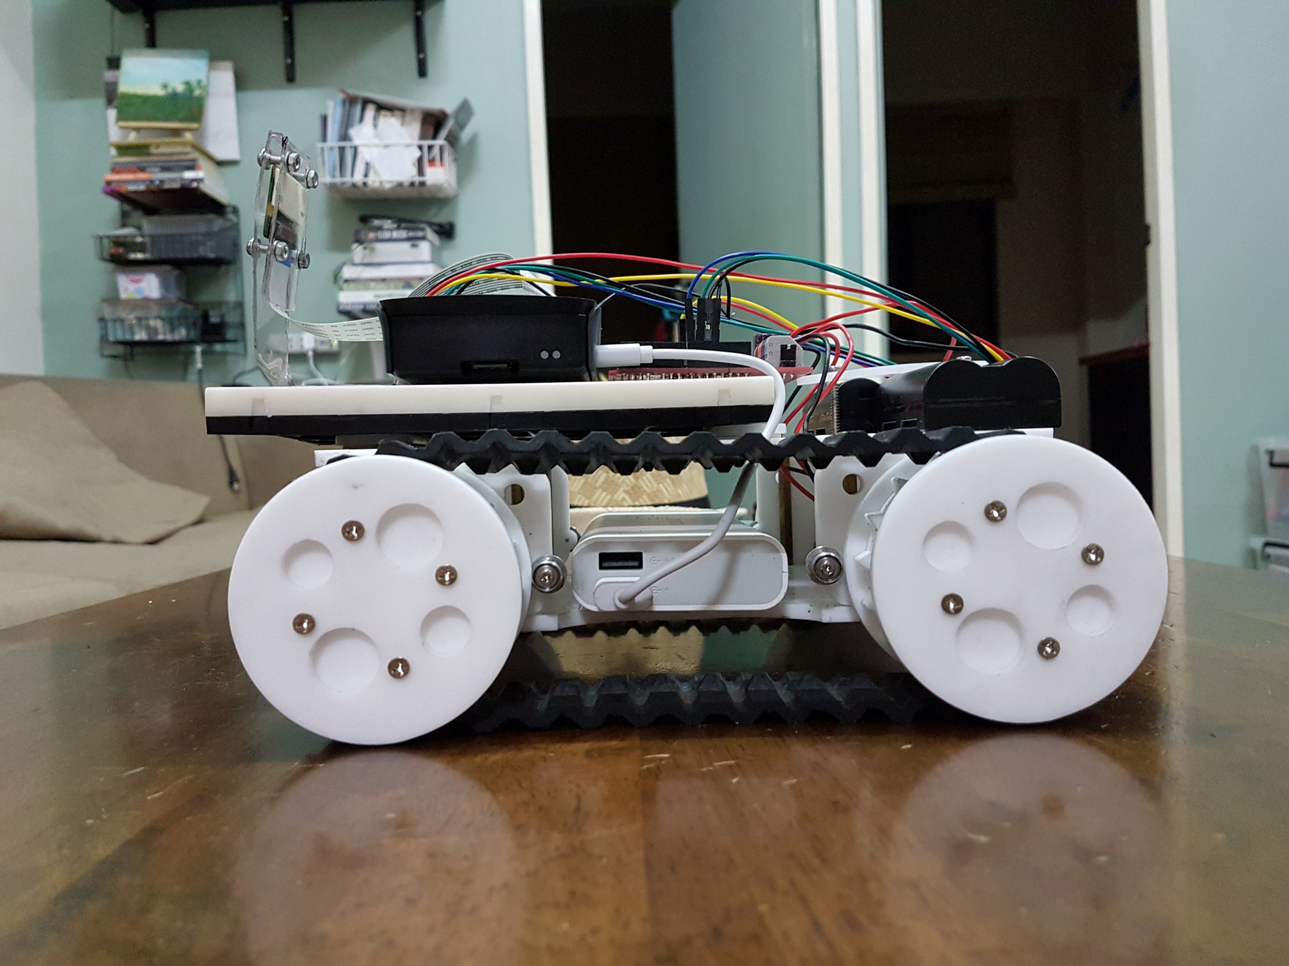
180 mm
262 mm

